Slide 1
Age-structured models

Slide 2
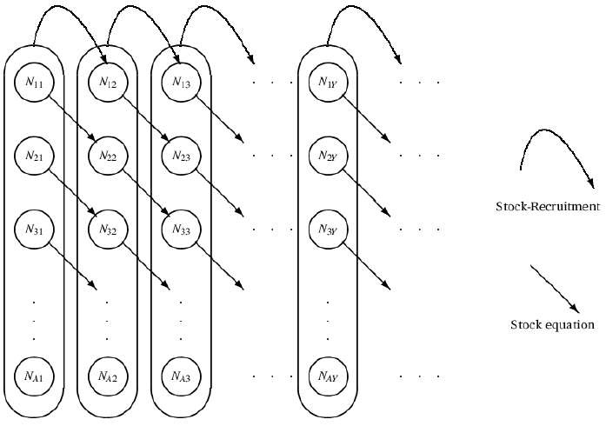
Age-structured models
Statistical catch-at-age
Estimate initial numbers and forward-calculate
Alternative: Virtual population analysis (VPA)
Estimate current numbers and back-calculate
Can account for processes occurring by age, not just the exploited population

Slide 3
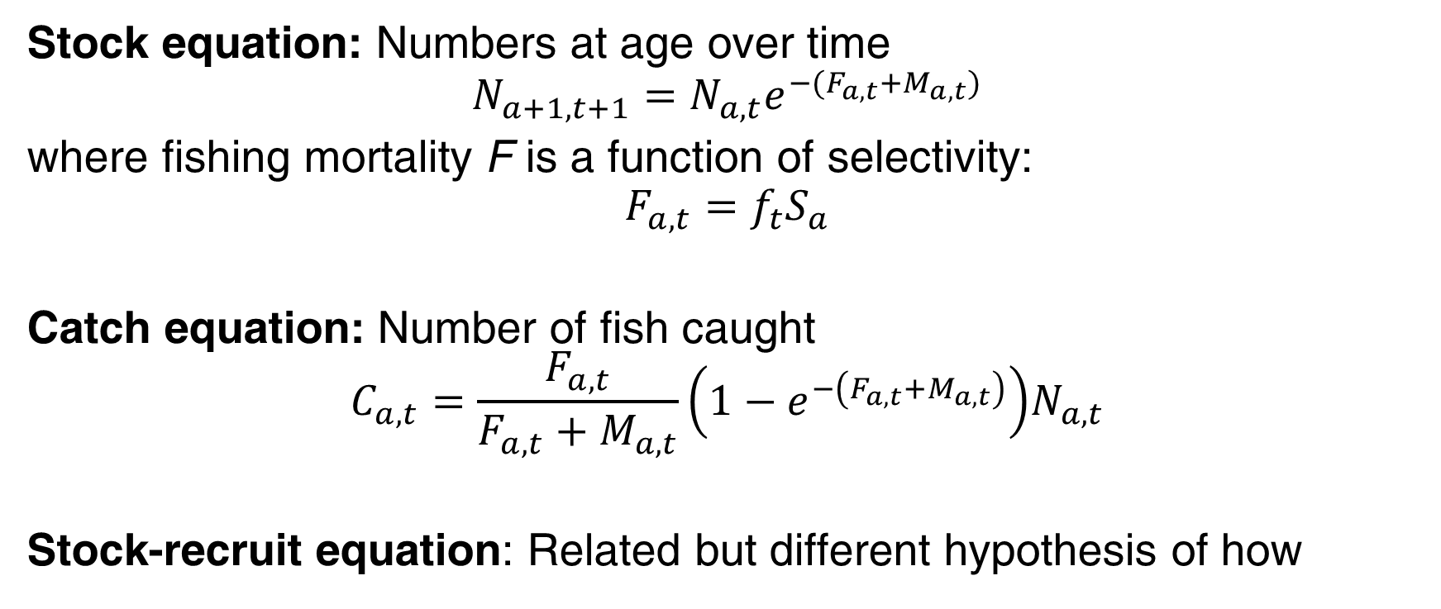
Basic equations
Stock equation: Numbers at age over time
$$N_{a+1,t+1}=N_{a,t}e^{−(F_{a,t}+M_{a,t})}$$
where fishing mortality F is a function of selectivity:
$$F_{a,t}=f_{t}S_{a}$$
Catch equation: Number of fish caught
$$C_{a,t}=\frac{F_{a,t}}{F_{a,t}+M_{a,t}}\left(1−e^{−\left(F_{a,t}+M_{a,t}\right)}\right)N_{a,t}$$
Stock-recruit equation: Related but different hypothesis of how

Slide 4
Stochastic (statistical) model
Acknowledges observation noise
Error structure part of the model description
Likelihood of actual observations optimized with regard to model parameters
+ Assumptions are transparent
+ Can compare different model assumptions
+ Can include different data sources
+ Estimate uncertainties
-- Tradeoff between number of model parameters and model flexibility
-- More advanced software needed

Slide 5
Statistical catch-at-age example
Estimating:
Numbers-at-age in the first year
Recruits (numbers age-0)
Fully-selected fishing mortality by year
Age at 50% and 95% selectivity
Catchability
Specifying:
Catch, CPUE, and proportions catch-at-age data
Natural mortality
Weight-at-age
Weights for the catch, CPUE, and catch-at-age data

Slide 6
Statistical catch-at-age example
Population dynamics Predicted catch
Logistic selectivity

Slide 7
Statistical catch-at-age example
Likelihoods
Catch CPUE Catch-at-age

Slide 8
Exercise
Compile and run age-structured model (start with AS1)
The model currently assumes the last age group consists of fish only age-12, when in reality it is age-12 and above. Create a plus group for the last age:
Catches of fish in the first age group are largely from discard estimates. Extend the model to use a separate variance for catches of fish in the first age group.
Extend the model to use one set of catchabilities for the first ten years, and a different set in the last 10 years.
$$N_{A,t}=N_{A−1,t−1}e^{−Z_{A−1,t−1}}+N_{A,t−1}e^{−Z_{A,t−1}}$$

Slide 9
Add a stock-recruit relationship
Assume fixed steepness h
Assume a Beverton-Holt stock-recruit relationship
Assume a Ricker stock-recruit relationship
Bring the results into R and compare models

